Slide 1
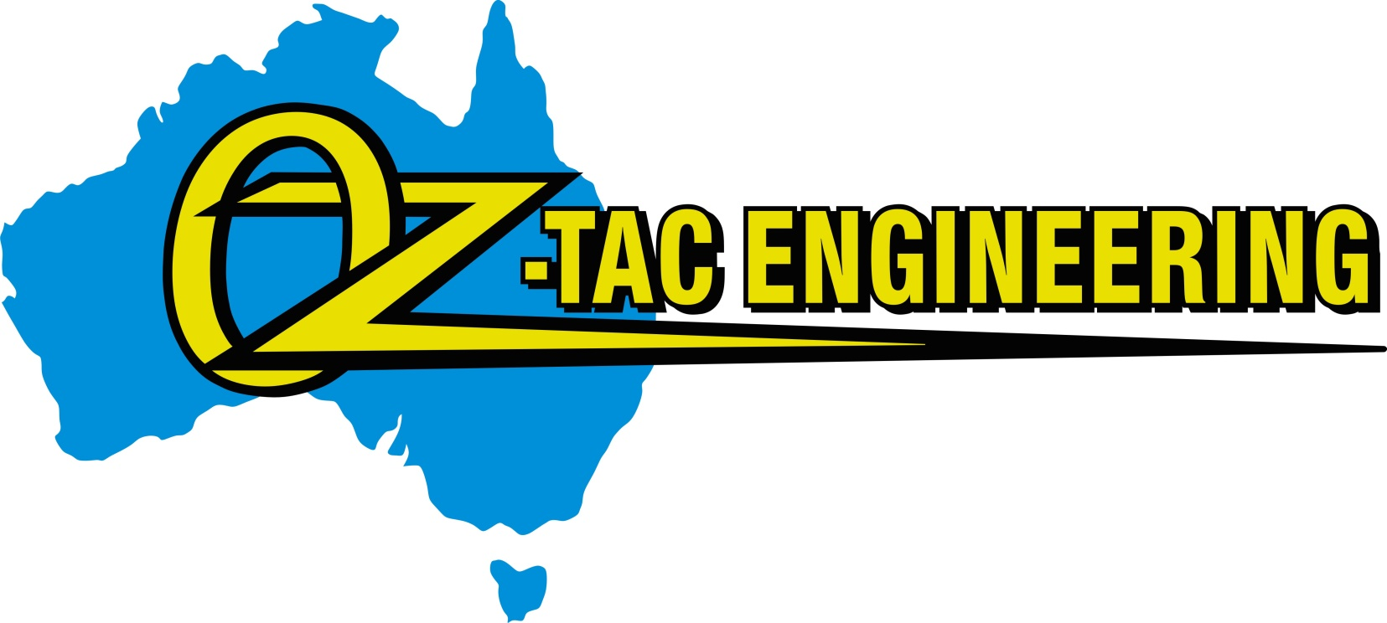
Capability, Assets and Company Values

Slide 2

Company Statement
Oz-Tac Engineering is a proudly Australian-owned and operated company specialising in the design, manufacture and delivery of custom, fit-for-purpose engineering solutions for the oil, gas, mining and construction industries. We combine practical engineering expertise, comprehensive in-house manufacturing capabilities and a commitment to quality, so we can deliver solutions for each, and every project.
Our key strength lies in our ability to manage projects from manufacturing drawing packages through to fabrication, abrasive blasting, industrial coatings, installation and commissioning. By providing an integrated, end-to-end service, we support greater control over quality, consistency and traceability while helping streamline project delivery and reduce the complexity of coordinating multiple suppliers.
Quality and compliance underpin everything we do. Our ISO 9001 and AS/NZS 5131 CC2 certifications support our commitment to controlled processes, while comprehensive manufacturing traceability, testing and compliance documentation provide clients with confidence in the integrity and performance of their components and equipment.
At Oz-Tac Engineering, we understand that reliability, workmanship and dependable delivery are critical to our clients’ operations. We focus on building strong working relationships, responding to project-specific requirements and delivering practical, durable solutions that meet the demands of challenging industrial environments.

Slide 3
Core Competencies
Custom Fit-for-Purpose Manufacturing: Expertly designed solutions tailored to meet the unique needs of the oil and gas, Mining, Timber manufacturing and construction sectors.
ISO 9001 Quality Management Systems: Rigorous adherence to internationally recognized standards ensures consistent quality and reliability.
Steelwork Compliance Australia AS/5131: Quality management system, fabrication processes, welding controls, and inspection procedures meet the requirements to manufacture CC2 structural steelwork.
3D Modelling and Drafting Engineering (RPEQ): Cutting-edge design and engineering services led by Registered Professional Engineers of Queensland, ensuring precision and compliance with industry standards.
End-to-End In-House Manufacturing: Comprehensive capabilities including design, engineering, fabrication, welding, abrasive blasting, powder coating, and painting.
Transportation and Site Delivery: Efficient logistics and transport solutions to ensure timely delivery and installation at client sites.

Slide 4
Differentiators
Innovation Focus: Leveraging the latest technologies and methodologies to provide innovative solutions that enhance operational efficiency and performance.
Customer-Centric Approach: Dedicated to exceeding client expectations through personalised service and a commitment to high-quality outcomes.
Comprehensive Service Offering: A complete suite of in-house services from conceptual design to final delivery, ensuring seamless project execution and quality control.
Experienced Team: Skilled professionals with extensive industry knowledge and technical expertise, including certified engineers welding specialists Electricians and instrument techs.
Certifications and Compliance: ISO 9001 certification for quality management, SCA CC2 certified, Licenced holder for QBCC, certified high-pressure and SP welding AS 1554, capabilities, AS 2214 welding supervisor’s, Working at Heights, Confined Space, Crane drivers and Dogman, Riggers,

Slide 5

Our Vision
Our goal is to be outstanding, and we are passionate about remaining at the forefront of technical innovation. That means having the best people, projects and clients, and providing the best service, solutions and advice.
Company Values
Innovation – All employees are encouraged to think independently and creatively so that we can continue to provide customized and innovative solutions to our customers
Quality - All employees strive to produce the highest quality product in the industry, pushing the company upward and providing effective solutions and added value to our customers
Improvement- Continually offer improvement opportunities and further training to every employee to stimulate continuous improvement in all aspects of our business
Compliance - Directors and employees are committed to complying with Australian Standards and Codes of Practice
Teamwork - Employees work as a team and combine their individual skills in pursuit of a common
goal sharing knowledge to help, guide and support each other

Slide 6

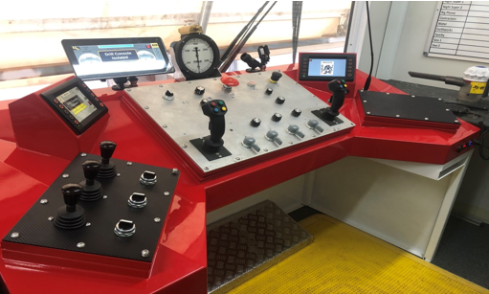
Capabilities
Design and drafting 3D modelling
Engineering services (RPEQ)
Safe design documentation
CNC profile cutting
Fabrication
Welding (MMAW GTAW GMAW)
Mobile welding
Non-Destructive Testing
Machining
CNC Milling
Abrasive blasting
Industrial coatings
Shut down and breakdown services
Sheet metal & light fabrication
  Stainless steel
  Aluminium
Pressure pipe welding.
Weld supervisor’s

Slide 7

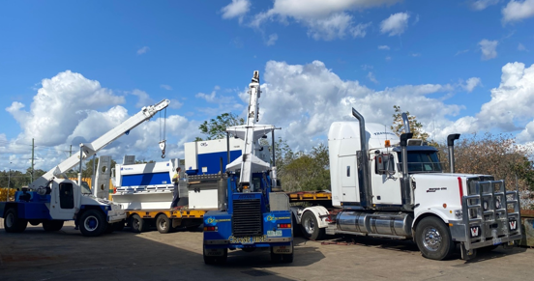
Assets
4000 m2 Workshop space
30000 m2 Laydown Yard
CNC Lathe
Centre Lathe
Milling Machine
CNC Plasma Cutter
Plate rollers
14t Franna Cranes
Powder coating booth and oven
18m x 6.5m x 6.5m Blasting booth
220m2 Painting booth

Slide 8
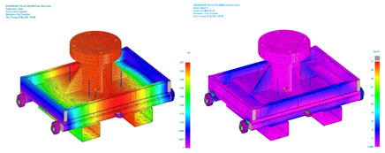
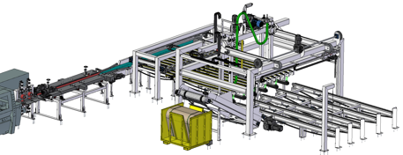
Capability Statement - Design.
Sample FEA (Condor Energy)
Core Competencies:
Experienced Design Team: Our design team comprises of professionals with many years of trade experience, providing the practical and realistic element to every project.
Advanced 3D CAD modelling: We create complete 3D models of all our projects using Solid Edge, a leading CAD package, best suited for mechanical and structural designs. We also produce all shop drawings and manufacturing specifications in house and can provide full MDR documentation as required.
RPEQ Engineers: We maintain a strong relationship with RPEQ engineers at Black Square Engineering for our external design verification and certification. This ensures that our designs meet the required standards of quality and compliance.
In-House FEA: Our in-house Finite Element Analysis (FEA) capabilities allow for detailed simulation and analysis, optimizing designs for performance and lifespan.
Short board infeed (Parkside Timber)

Slide 9
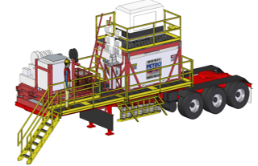
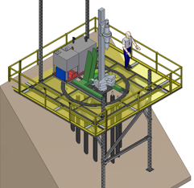
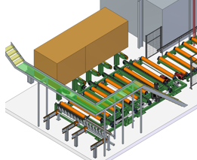
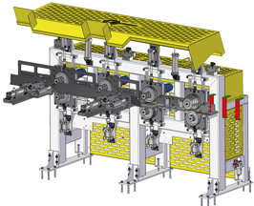
Past Performance
Oz-Tac Engineering has a proven track record of delivering complex projects with exceptional results (see sample projects below). Our diverse portfolio demonstrates our ability to tackle challenges and exceed client expectations.
Fuel trailer with hydraulic walkways (Nitschke Energy)
Kiln pack transfer (HYNE Timber)
Moulder Feed Unit (Parkside Timber)
Concept Heli portable drill pad (PCA Ground Engineering)

Slide 10
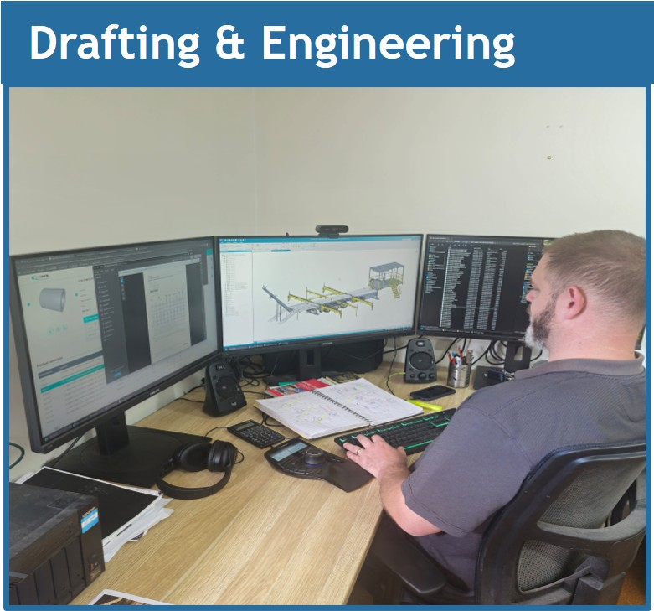
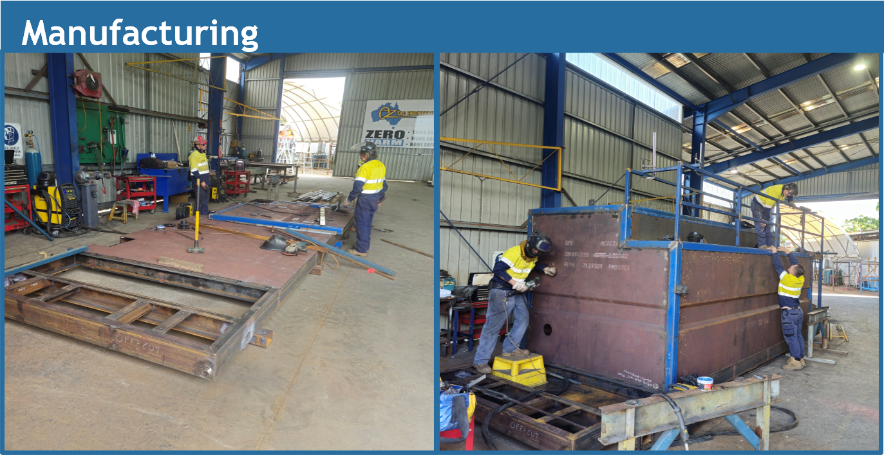
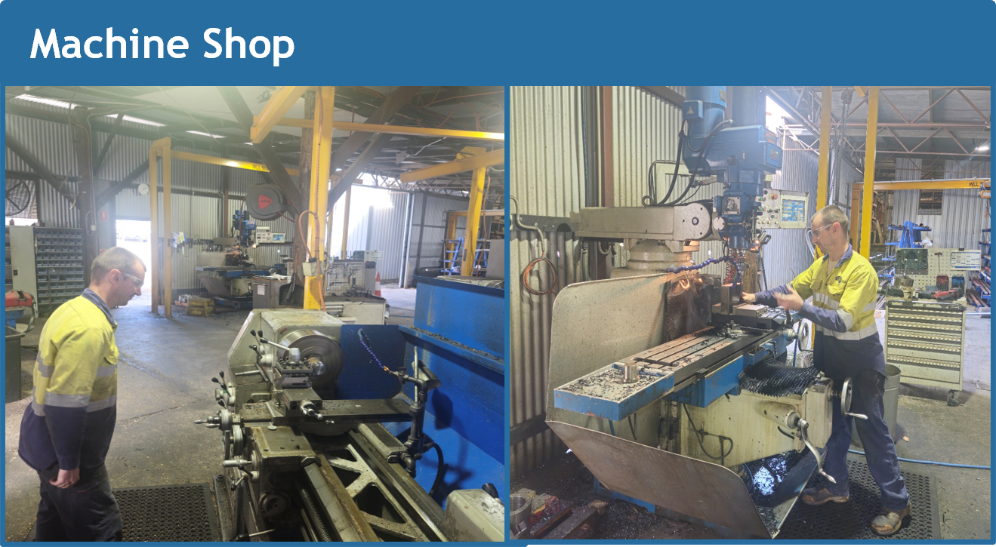
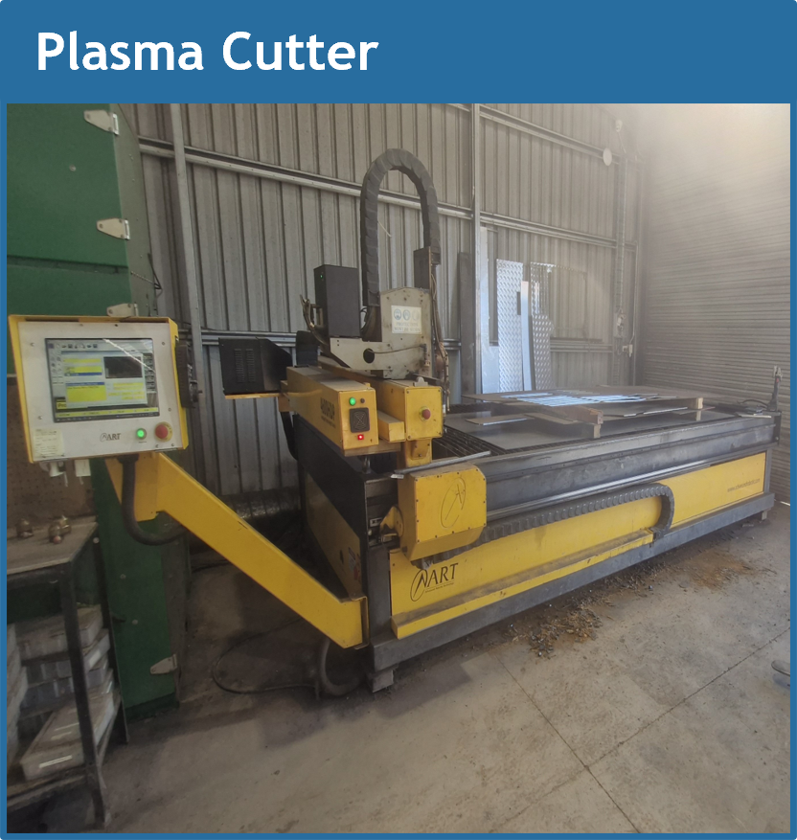
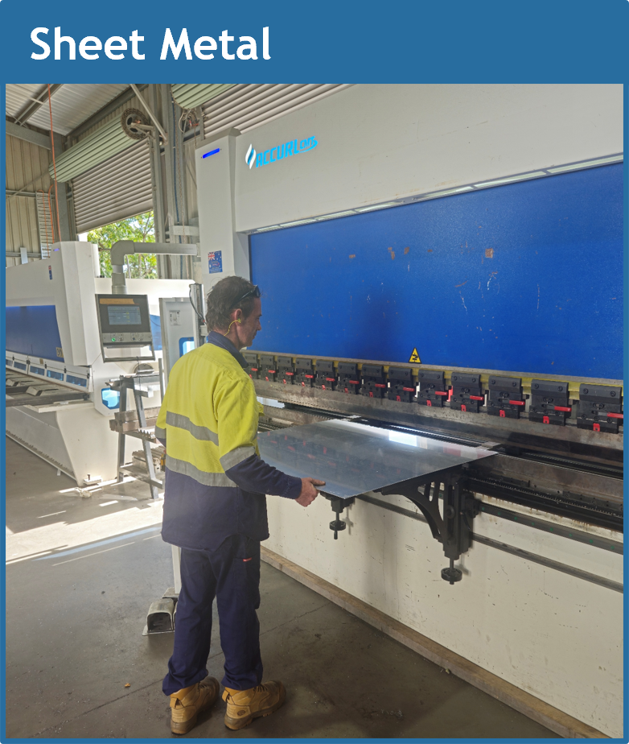
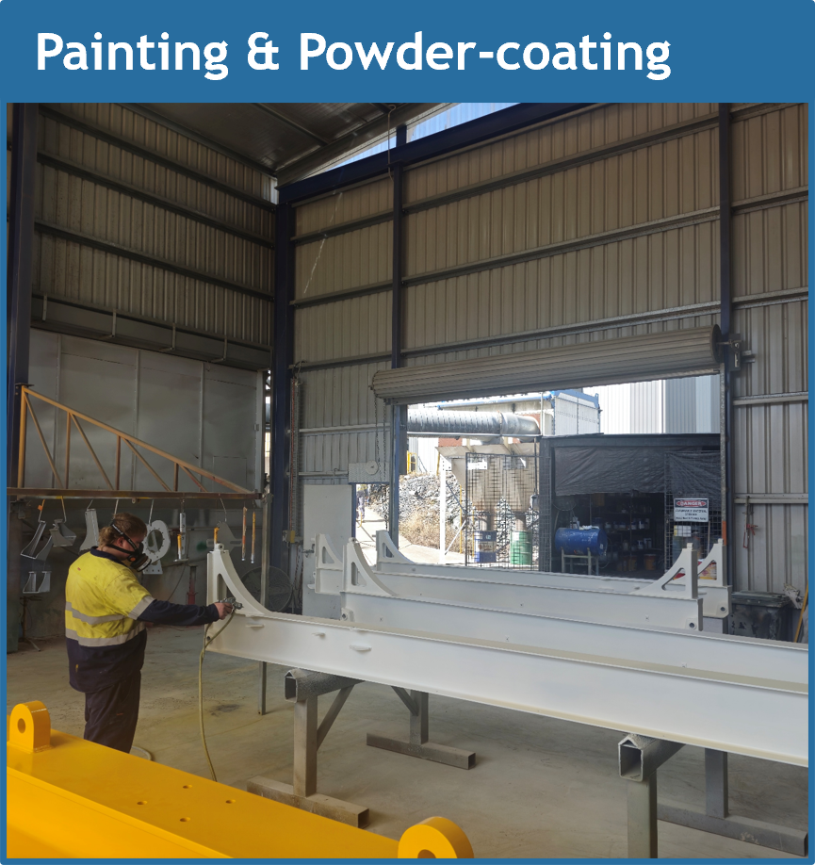
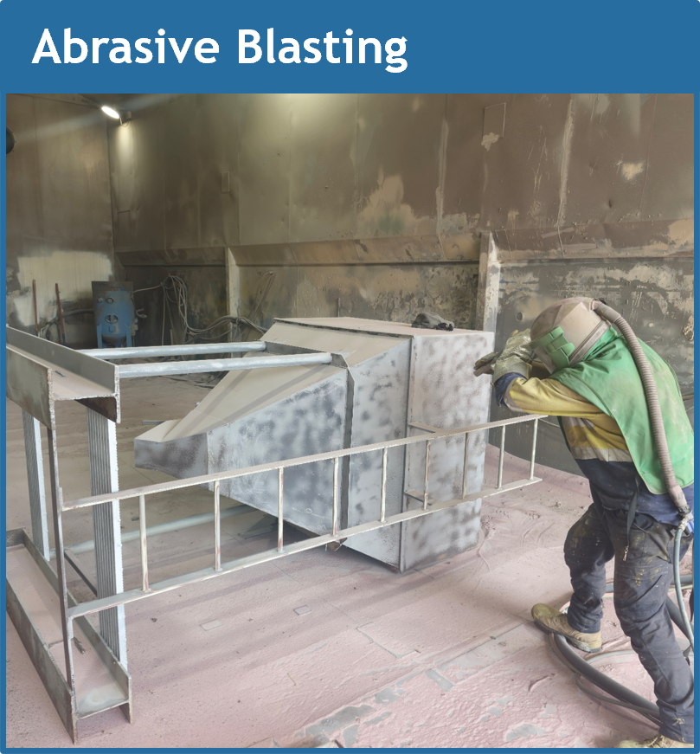
Workshop Processes

Slide 11
Compliance
FABRICATION & INSPECTION
Steel processing
Dimensional inspections
Fit-up inspections
Welding inspections
ITP Hold / Witness points
NDT where specified
NCR / rework control
LOGISITICS & TRANSPORT PLAN
Transport methodology
Load dimensions & weights
Oversize / overmass requirements
Permits & route planning where required
Load restraint
Delivery sequence
Site access & unloading requirements
PROJECT / CONTRACT REVIEW
Scope, drawings & specifications reviewed
Applicable Australian Standards identified
Client requirements identified
Design responsibility & RPEQ requirements confirmed
CC2 / execution class requirements confirmed
QUALITY MANAGEMENT PLAN
Project-specific Quality Plan
Inspection & Test Plans (ITPs)
Hold / Witness / Surveillance points
SCA CC2 requirements
Inspection and testing requirements
MDR / handover requirements established
SURFACE TREATMENT
SITE INSTALLATION / ERECTION PLAN
Installation methodology
Site-specific JSA / SWMS
Crane & lifting requirements
Erection sequence
Temporary works where required
Survey / alignment requirements
Installation ITP & Hold Points
Final inspection
INDUSTRIAL COATINGS
Surface preparation
Blast cleanliness
Blast profile
Climate conditions
Wet Film Thickness
Dry Film Thickness
Coating records
GALVANISING
Galvanising specifications
Vent / drain requirements
Coating inspection
Coating thickness
Repair requirements
ENGINEERING & DRAWING CONTROL
Design / engineering review
RPEQ certification where required
Workshop drawing review & approval
Drawing revision control
RFIs / design changes controlled
Approved drawings released to production
PROJECT MANAGEMENT PLAN
Project team, roles & responsibilities
Contact names & numbers
Communication / RFI process
Client vs Oz-Tac policies & procedures
Applicable standards & specifications
Bridging document where required
Document control & revision management
COMMISSIONING & CLIENT HANDOVER
Functional testing where applicable
Defect / punch list close-out
As-built documentation
MDR / QA dossier
Certificates & inspection records
Client acceptance / handover
MATERIAL PROCUREMENT & TRACEABILITY
Approved material specifications
Material certificates / MTCs
Incoming goods inspection
Heat / batch traceability
Material identification maintained
Non-conforming material quarantined
FINAL QA & COMPLIANCE RELEASE
Final dimensional inspection
Drawing / specification compliance
ITP completion
NCRs closed
Traceability verified
Coating records completed
MDR compiled
QA release for dispatch
RISK & SAFETY PLANNING
Project risk assessment
JSA
SWMS
Safe Design risks transferred to construction
High-risk activities identified
Site-specific requirements
PROJECT CLOSE-OUT
SAFE • COMPLIANT • TRACEABLE • DOCUMENTED

Slide 12
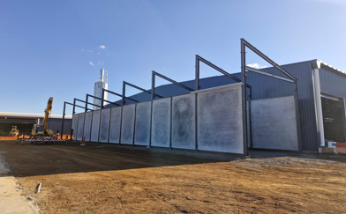
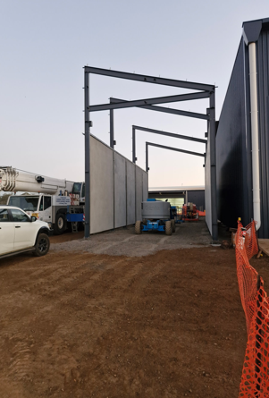
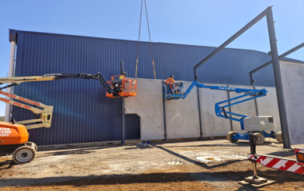
Case Study One.
Fuel storage bunker
Scope of works
Design and engineering Civils, Footings, floor
slab and tilt panel design.
Design and engineering of Structural steel.
Fabrication and blast and painting of Steel work.
Installation of steel steelwork.
Site form work of tilt panels.
Standing and fixing of tilt panels.

Slide 13
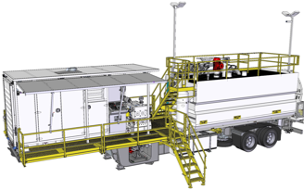
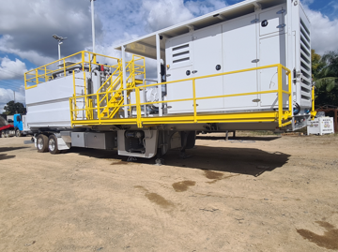
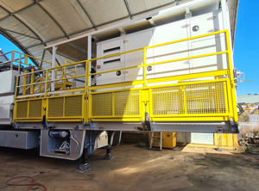
Case Study Two.
Mud system gen 2 Oz-tac engineering designed for the mining and gas industry.
System capable of 7 BBL per minute at 5000psi.
Features 200 BBL 2 compartment tank.
High pressure hose reel 10,000psi.
Centrifugal mix pumps mounted under chassis for continuous prime with filter system and rock catcher.
Powered by cat C15 engine with Alison automatic transmission.
800L fuel tank built into engine skid.
600 horsepower triplex pump.
Hydraulic fold away walkway and stair system.
Venturi Mix system with hopper.
11KW aggregation system.
Engine and transmission mounted in a sound encloser
Tested at 87 decibel at 7m.

Slide 14
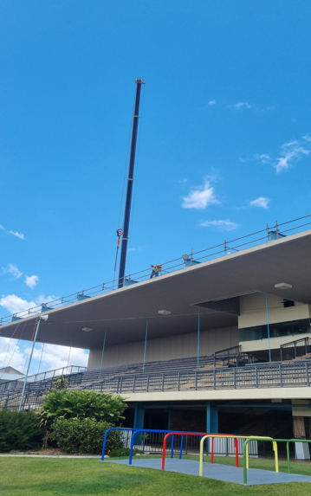
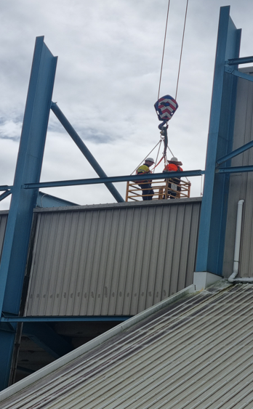
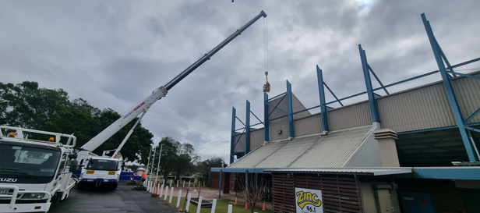
Case Study Three.
Gympie show grounds refurb of
Grandstand.
Scope of works.
Complete all repair works to
Structural steel sections as per engineer’s report.
Develop ITP’s for Engineer’s to sign off.
Blast and paint.

Slide 15
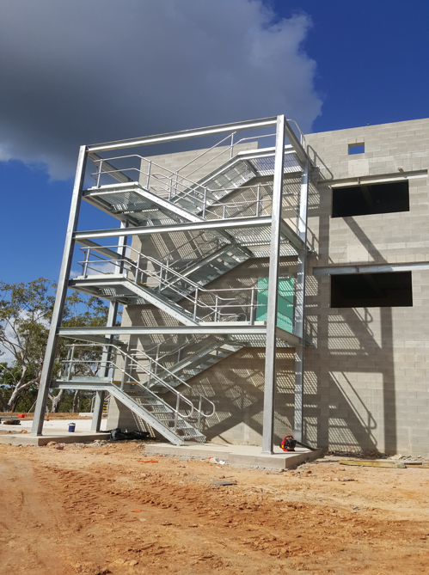
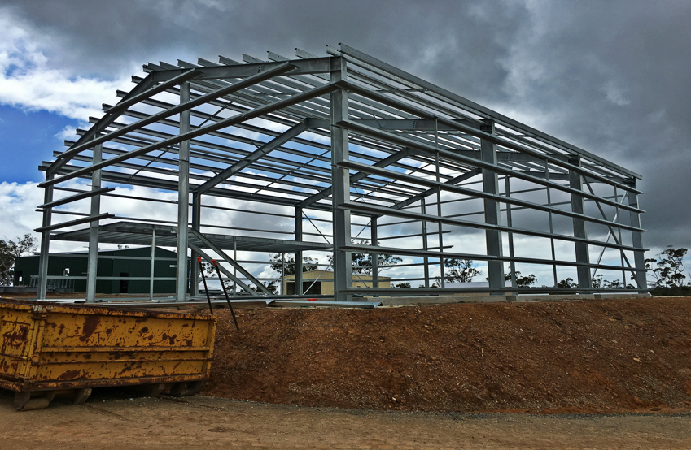
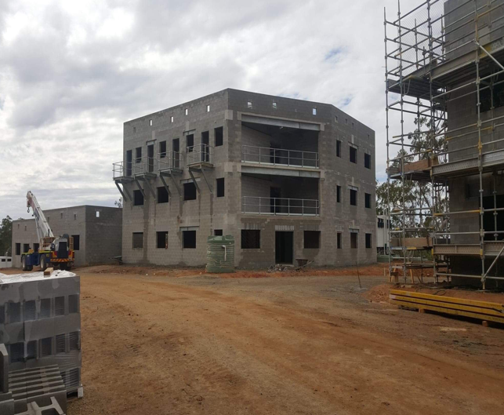
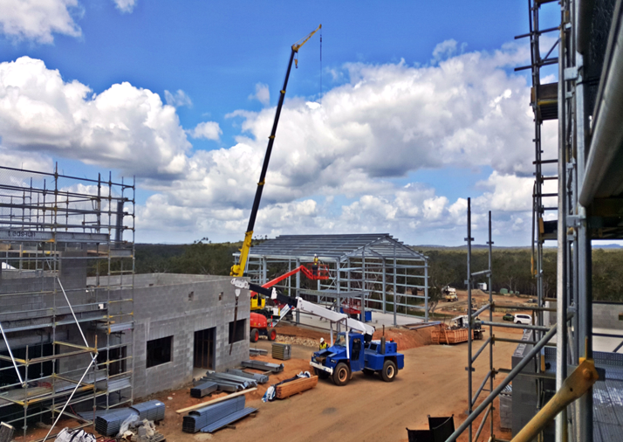
Case study Six
WBTA Live Fire Training City – Australian Defence Force (ADF)
Oz-Tac Engineering was proud to be awarded the contract to manufacture and install all structural steel for the WBTA Live Fire Training City project.
This significant Defence infrastructure project comprised the fabrication and installation of structural steel for 18 buildings, all delivered by our experienced in-house team.
From detailed planning and precision fabrication through to on-site installation, this project showcases Oz-Tac Engineering's capability to deliver complex structural steel solutions for critical infrastructure projects.
We are proud to support the Australian Defence Force by delivering high-quality Australian manufacturing, built to the highest standards of safety, quality, and workmanship.

Slide 16
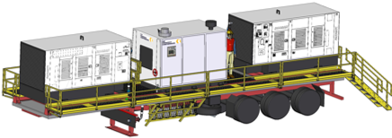
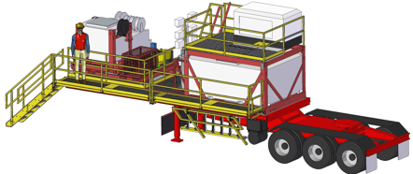
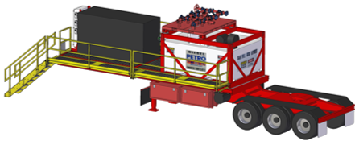
Case Study Four.
Air pack, fuel & generator trailers.
Removeable stairs for transport and hydraulic fold up walkway system to comply with AS1657.
Air pack trailer features two compressors and a booster, with high pressure pipe work manufactured in-house.
Fuel trailer features a 6000L fuel pod and a lighting tower powder by a small generator.
Generator trailer also features a 6000L fuel pod to fuel the generator and OEM toolboxes.

Slide 17
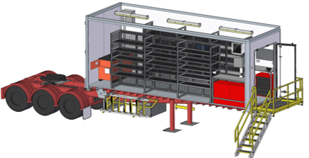
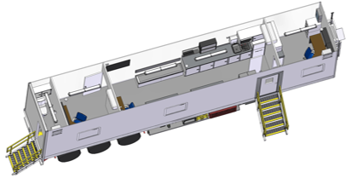
Case Study Five
Workshop & office trailers, built for the drilling industry. Featuring detachable stairs that can be stored away during transport. Designed to be used in A-B double combination.
The workshop trailer features a hydraulic walkway which the stairs are attached to, two large storage tool cages, workbenches specially designed to go over the toolboxes to conserve space, flammable goods storage shelf and a slide out generator for easy maintenance.
The office trailer has a fully functional bathroom with a macerating toilet, a kitchen and lunch-room table which fits 6-9, with two closed offices and one desk in main area and is fully air conditioned.

Slide 18

Organization Chart
General Manager
Luke Edwards
BD Manager
Luke Edwards
Innovation/ Major Projects
Production Manager
Jamie O’Meara
Finance Manager
Natasha Scott
Client Manager
Michael Ross
Paul Young
Workshop Manager
Keith Harrison
Sheet WS Manager
Rusty Whittaker
Senior Draftsperson
Johnathan Grieger
Project Manager
Rusty Whittaker
Accounts
Welding Supervisors
Luke Edwards
Iszac Neville
Stores & Purchasing Officer
Coordinator
Admin
Staff
Tradespersons
Tradespersons
Design Team
Tradespersons
Tradesperson

Slide 19

Key Company Personal
Luke Edwards General Manager | 23 years as Managing Director of Oz-Tac Engineering Certificate 4 in Engineering Qualified Weld Supervisor 27+ years Trade Qualified Boilermaker 15+ years of experience manufacturing plant and equipment for the oil gas and mining industry Advanced knowledge of Australian Standards & Codes of Practice
Ty Horne Projects Manager | 23 years as Director of Oz-Tac Engineering 25+ years as a qualified Boilermaker Specialising in Advanced Sorting Systems in the Timber Manufacturing Industry
Johnathan Grieger Senior Draftsperson | Bachelor of Engineering (Mechanical) Trade Qualified Fitter/Machinist 15+ years Industry Experience
Paul Young Project Manager | 30+ years Trade qualified Boiler Maker 20+ years experience managing fabrication and mechanical workshops
Jamie O'Meara Production Manager | 20+ years experience in the Manufacturing Industry Trade Qualified Advanced knowledge in Quality Management Systems (ISO.9001) Document and ISO.9001 Controller
Keith Harrison Workshop Manager | 30+ years Trade qualified Diesel Fitter 20+ years experience managing fabrication and mechanical workshops 15+ years experience in the Oil, Gas, Mining & Drilling Industries

Slide 20




Supported by;

